Slide 1
HOM - Process Analysis Methods

Slide 2
What is Process Management?
Describe a process
Determine resource utilizations
Determine flow times for producing products or services
Do what if analysis
The key problems addressed are whether there is adequate capacity to meet demand? Whether the demand can be met within time? Whether the operating costs are aligned to the generation of revenue?

Slide 3
How to describe a process?
Equal part art and science
How much detail to capture?
The viewpoints taken here
Workcenters and labor types comprise the resources used to perform various steps to deliver products and services
Products make demands on the resources in a pre-specified sequence called a recipe. Products or services arrive to the facility and demand service.
Product recipe sets out the timing for each step and which resources are used in each step

Slide 4
How does the module work?
Given a process description it calculates the utilization of each resource
Uses simulation to determine the flow times for each product or service. (Flow time is the end-to-end process time including waiting times at various steps)
Why simulation?
Helps illustrate rules of operations and their impact on delivery times. Specifically, lotsizing, scheduling and priority rules. These impact performance even without any uncertainty
Capture uncertainty in arrival of demand and uncertainty in processing times

Slide 5
Process Analysis - Steps
Step I: Naming Products, Workcenters (Machines)
and Labor Types
Step II: Enter workcenters (Machines) data
Step III: Enter Labor data
Step IV: Enter Products data
Step V:
a). Calculate Utilization
b). Calculate Flow time

Slide 6
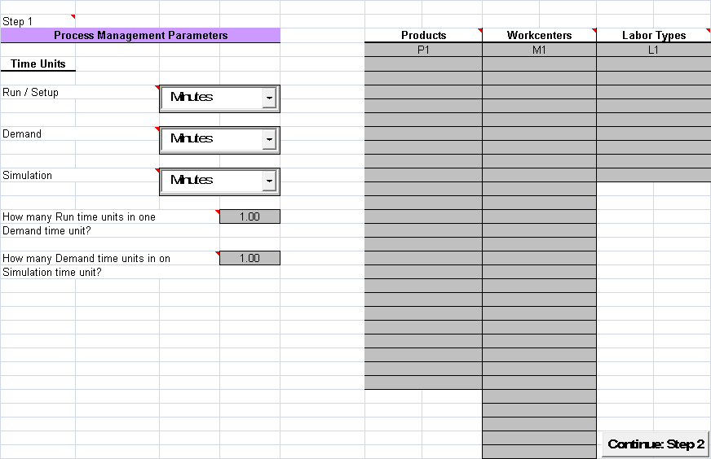
Opening Screen

Slide 7
Process Analysis - Steps
Step I: Naming Products
HOM permits the modeling of up to 25 different products, up to 30 workcenters and gives you the opportunity to specify up to 10 types (classes) of labor.
Consider a simple process where a customer orders a sandwich (1 minute), which is then assembled from pre-prepared ingredients (5 minutes) and payment is made when the order is delivered (2 minutes).
Orders are received regularly and every 10 minutes.

Slide 8
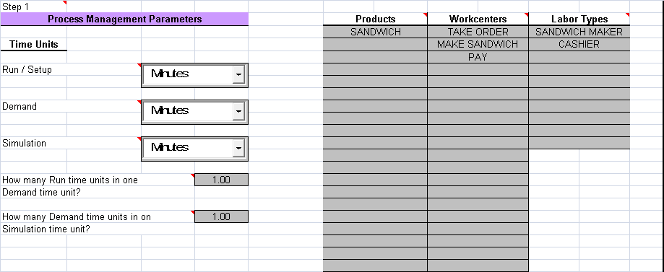
Step I Data Entry

Slide 9
Process Analysis – More details
Execution of each step in a process requires a workcenter and a labor type.
Denote a specific skill or experience category.
For example, some workcenters might require labor with a particular skill (cook, machinist, repair person, cashier, or clerk).
A bakery may require decorators, bakers, mechanics, and unskilled labor.
Hospitals may need scrub nurses, floor nurses, nurse’s aides, and so on.
You may ask why every step requires both a workcenter and a labor type?
Also, how to model multiple resources required for performing each step?

Slide 10
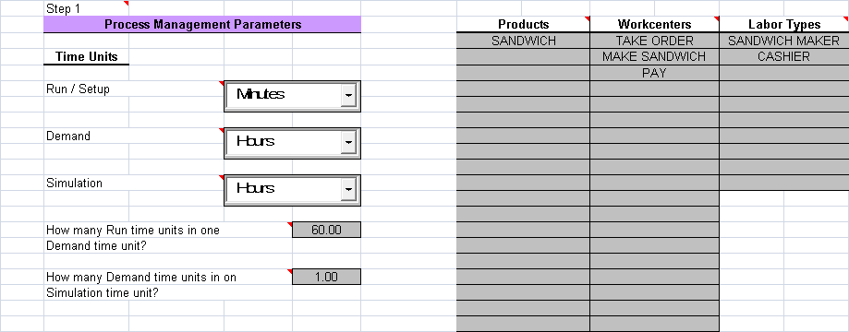
Enter time units data
Why do we allow different time units? It is sometime convenient to specify demand per month, processing time in minutes and simulation over a year.
Available units are minutes, hours, days, months and year.
Default conversion factors are specified that can be overridden by the user.

Slide 11
Click ‘Continue: Step 2’ button
Warning: Once you go to Step 2 returning is not possible without deletion of all data.
Warning: Make sure you have specified all the names of the machines, products and workcenters. There is a work around which is some what cumbersome if you forgot to name a machine. Before going back to Step 1 you can save the current data. Then, go to step1, reload the saved data, then add the name of the machine that you forgot.

Slide 12
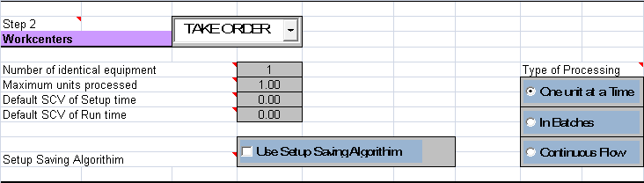
Step II: Enter workcenters (Machines) data
Number of identical machines: In service operations if no machine is involved just make this equal to the number of workers.
Maximum units processed: This is maximum number of units that be processed at a time without requiring another set up. This is very useful to break up a lot for a batch process or share the set up time when demand comes in ordersize greater than 1.
SCV: The squared coefficient of variation is the variance divided by the square of the mean. A deterministic processing time has SCV = 0. Exponential processing times have SCV = 1. Default value = 0.3. You can override these values in next step.

Slide 13
Step II: Enter workcenters (Machines) data
The scheduling rule will postpone the processing of a job if the lot size can be made as close to the maximum units (i.e., 3) as possible by waiting. The workcenter is programmed to wait for the rest of the order to arrive at the workcenter.
Setup saving algorithm: If checked the workcenter will not incur an additional setup if another lot of the same product is waiting and can be processed.
This version of HOM can not combine different orders and use a common set up except when set up saving is selected.

Slide 14
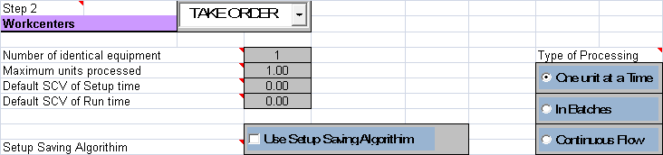
Step II: Enter workcenters (Machines) data
One unit at a time
This is the model of a machine that has setup as well as run time. Nothing else can be done on this machine during its setup and run time. The machine setup is finished after the maximum of the machine setup time and the labor setup time has elapsed.
The machine is considered to be free after the setup is completed and a duration equal to the machine run time has elapsed. Labor is considered to be free after the setup time for labor plus the run time (if any) for the labor has been completed.
The job is completed after the setup has been finished and an additional duration equal to the maximum of the machine and labor run times has elapsed.
Make sandwich is similar to take order.

Slide 15

Step II: Enter workcenters (Machines) data
We have chosen to model the Pay step as a batch process.
Any run time specified for a batch process will be ignored.
The entire order (up to the capacity limit – Maximum units processed) will be processed in one batch.
What is continuous flow process?
Click on continue to step 3. You can go back and forth between these steps. Only remember that changes made without going to step 2 will not get reflected in steps 3 or greater!

Slide 16
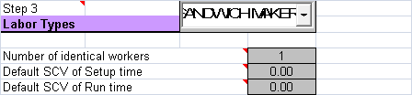
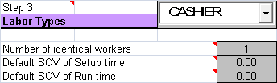
Step III: Enter Labor Data
We shall assume there is one sandwich maker and one cashier.
Their processing times have a default SCV. We can set these equal to zero to indicate that processing times are deterministic (unless otherwise specified).
Click to continue to Step 4.

Slide 17
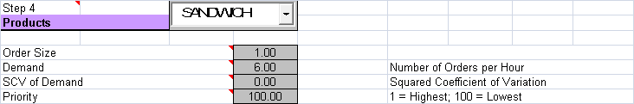
Step IV: Enter Products demand data
Order Size: This is the order quantity per order (also called unit of analysis)
This should be a whole number!
Demand: This is the average number of units of demand per unit of time. This can take fractional values. In our example orders arrive every 10 minutes.
SCV
Priority: This can take values 1 through 100. A low value represents high priority!

Slide 18
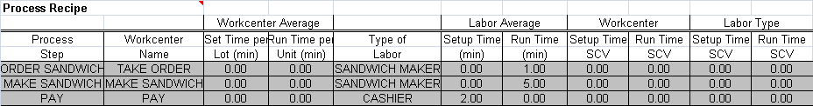
Process Analysis - Steps
Step IV: Enter Recipe
Process Step: This is simply a label
Workcenter Name: Must be from list in Step 1
Here we assume that the workcenter do not consume time.
Type of Labor: Must be from list in Step 1
Notice SCV values are automatically populated using the default values.
These can be over ridden.
Continue to Step 5. The hard work is over. Data has been entered and verified to a degree.

Slide 19
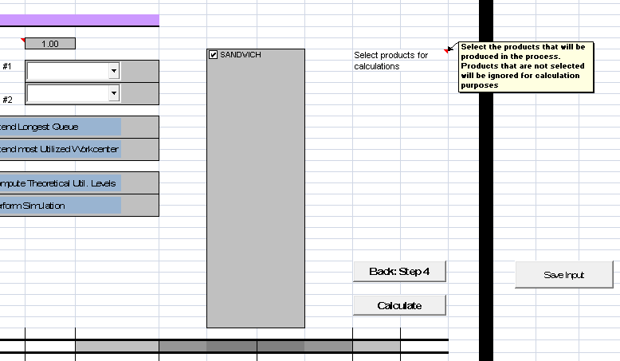
Process Analysis - Steps
Step V: Select products

Slide 20
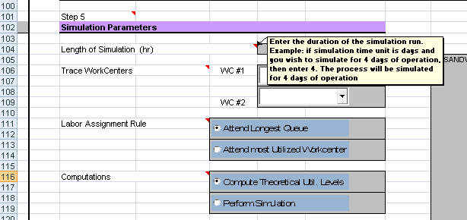
Process Analysis - Steps
Step V: Length of simulation
Set it to 100 hours
The length of the simulation will depend on the process being simulated.
The thumb rule is that the outputs should become “stable” – quantities produced per unit time, flow times, queue lengths etc.

Slide 21
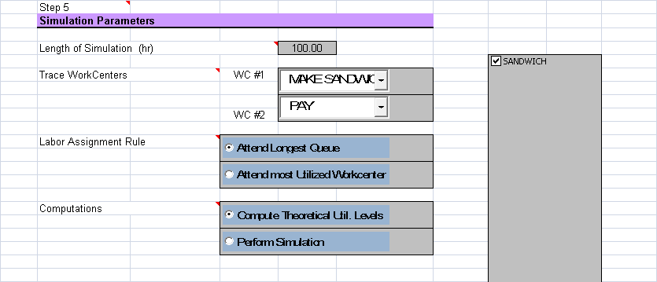
Process Analysis - Steps
Step V: Other settings
You can choose to trace job flows at two workcenters (to study in detail job flow)
Sometimes to reduce congestion one might like to attend the most utilized workcenter when there is a choice to be made.
First compute theoretical utilization levels to check your model!

Slide 22
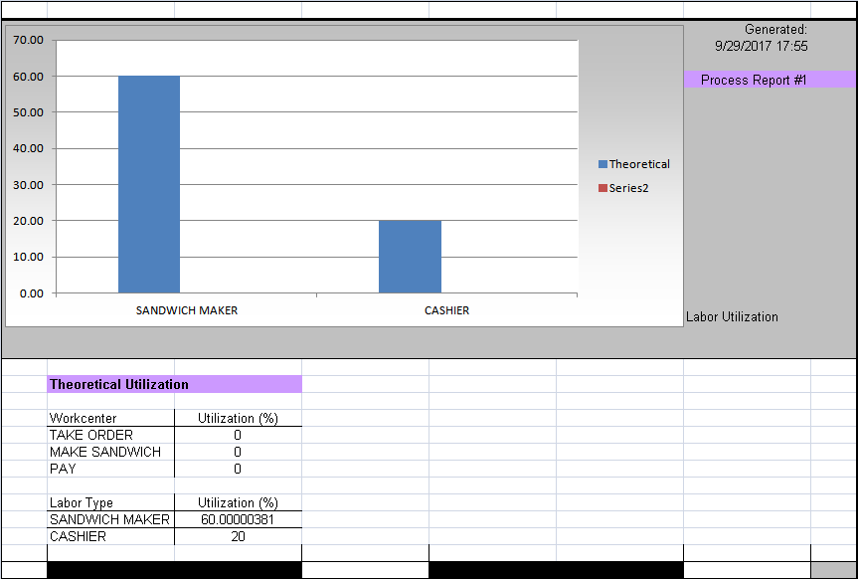
Process Analysis - Steps
Step V: Calculate Utilization – click on calculate
You can see utilizations are less than 100.
Go back to HOM sheet. Select Perform Simulation.
Calculate.

Slide 23
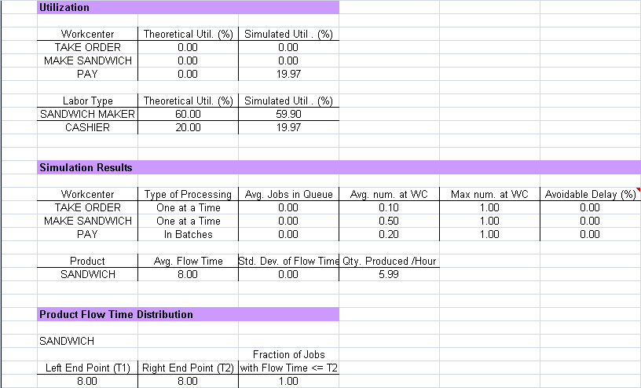
Process Analysis - Steps
Step V: Calculate Utilization & Flow time
This deviation is because machine set up is not complete until labor finishes set up!
** There is a small glitch in showing the graph. Will fix it.

Slide 24
Next steps
Modeling uncertainty
Machine interference
Modeling priorities
In class exercises
Go back to step 1 then step 2 then step 1
always before reloading a model! This clears internal database

Slide 25
Modeling uncertainty
Open Cookie1doz.xls
Examine the product recipe. Run the simulation for 100 days.
What is the flow time?
Change the SCV of demand to 1.
Run the simulation for 100 days.
What do you see?

Slide 26
Machine Interference (advanced topic)
What is machine interference? How to identify its presense?
How to fix it?
Make the Helper load the oven
Use set up saving – where?
Try each separately. Let us discuss what happens.

Slide 27
Modeling priority
Open the file mm1example.xls
There are two classes of customers – each arrive at the rate of 0.4 per minute. The processing time is 1 minute for either class. Both service time and demand have SCV = 1 (which makes it a M/M/1 queue).
Initially priority is set equal for both classes.
Simulate and observe the flow times.
Now set the priority for one class to be higher and simulate. What do you observe? You should identify what has changed and what has NOT changed. What has NOT changed such as total queue lengths (in general work in the system)! These are invariant in work conserving systems.

Slide 28
Tasks
I am ambitiously scheduling three in-class tasks. Work in groups of two. I am available for clarifications.
First one gives you practice modeling a process using a case study which you may know (pizza pazza)
Second gives an idea of flow time reduction using lotsizing.
Third, which is the most complex (seemingly) addresses an underwriting company’s dilemma.

